Slide 1
WTH is a debugger

Slide 2
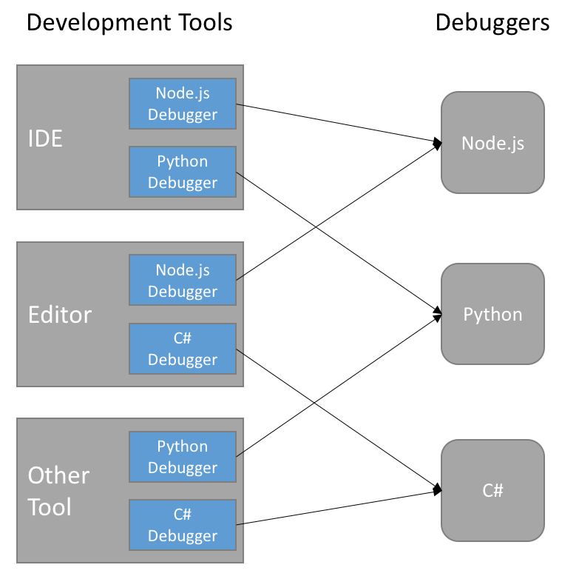

Slide 3
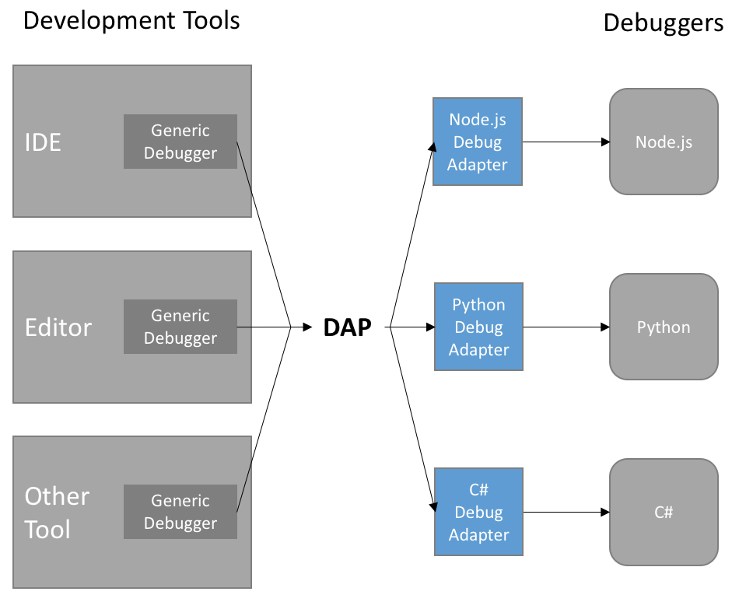

Slide 5
Best Practices
Debuggers are not for testing
They cannot trace race conditions
For c++ -O0 is the only compile optimization, which allows debugging

Slide 6
When it is sometimes better to do printf(…)

